Slide 1


010101001111010101001100010101010101010011000101010110100100010101010010
010110110101010101011101011010001001
圖片來源：https://www.flaticon.com/
伴學松
Decode Module
010101001111010101001100010101010101010011000101010110100100010101010010
010110110101010101011101011010001001

Slide 2
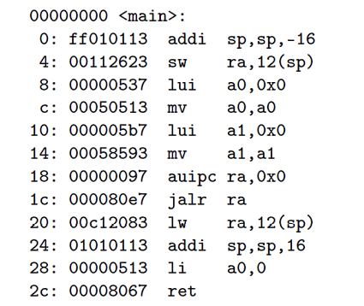
010101001111010101001100010101010101010011000101010110100100010101010010
010110110101010101011101011010001001
int main (void)
{
printf(“Hello world!\n”);
return 0;
}
我們看得懂
機器看得懂
010101001111010101001100010101010101010011000101010110100100010101010010
010110110101010101011101011010001001

Slide 3

010101001111010101001100010101010101010011000101010110100100010101010010
010110110101010101011101011010001001
圖片來源：https://www.ettoday.net
010101001111010101001100010101010101010011000101010110100100010101010010
010110110101010101011101011010001001

Slide 4
010101001111010101001100010101010101010011000101010110100100010101010010
010110110101010101011101011010001001
高階語言
int x = 6;
int y = 2;
int z = x << y;
int j = x << 2;
編譯器
Compiler
組合語言
li a0 6
li a1 2
sll a2 a0 a1
slli a3 a0 2
組譯器
Assembler
機器語言
0: 00600513
4: 00200593
8: 00b51633
c: 00251693
010101001111010101001100010101010101010011000101010110100100010101010010
010110110101010101011101011010001001

Slide 5


010101001111010101001100010101010101010011000101010110100100010101010010
010110110101010101011101011010001001
圖片來源：https://www.flaticon.com/
0: 00600513
4: 00200593
8: 00b51633
c: 00251693
連結器
Linker
可執行檔
010101001111010101001100010101010101010011000101010110100100010101010010
010110110101010101011101011010001001

Slide 6


010101001111010101001100010101010101010011000101010110100100010101010010
010110110101010101011101011010001001
圖片來源：https://www.flaticon.com/
載入器
Loader
可執行檔
如何知道
需要運作的步驟？
010101001111010101001100010101010101010011000101010110100100010101010010
010110110101010101011101011010001001

Slide 7
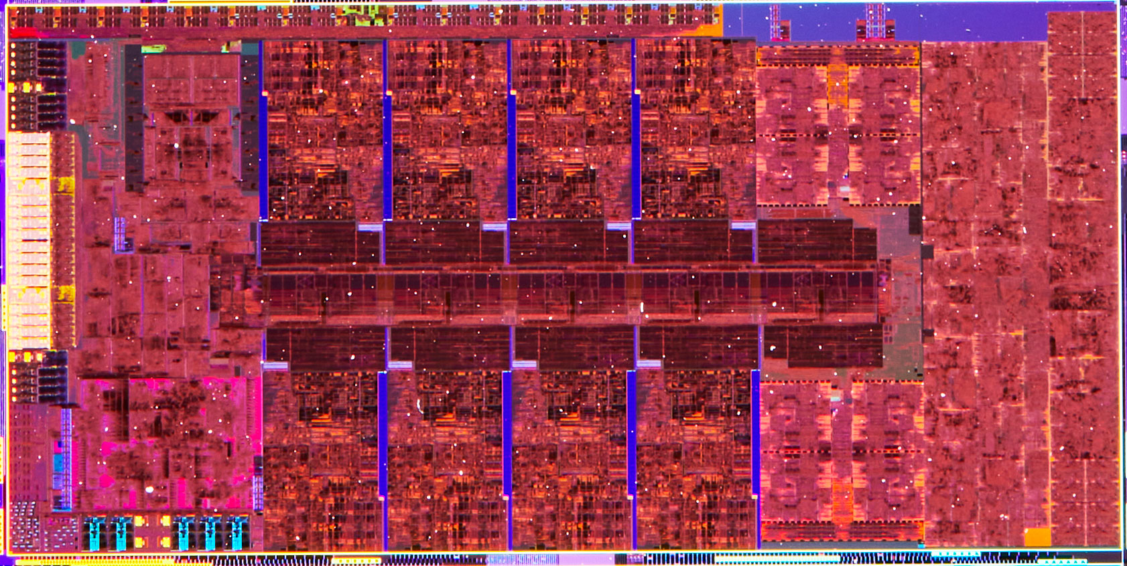
010101001111010101001100010101010101010011000101010110100100010101010010
010110110101010101011101011010001001
圖片來源：https://www.techpowerup.com
010101001111010101001100010101010101010011000101010110100100010101010010
010110110101010101011101011010001001

Slide 8
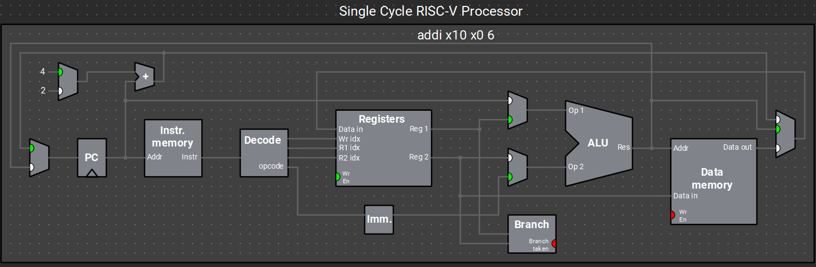
010101001111010101001100010101010101010011000101010110100100010101010010
010110110101010101011101011010001001
圖片來源：Ripes - visual computer architecture simulator
010101001111010101001100010101010101010011000101010110100100010101010010
010110110101010101011101011010001001

Slide 9

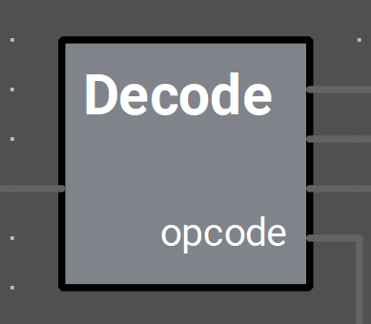
010101001111010101001100010101010101010011000101010110100100010101010010
010110110101010101011101011010001001
圖片來源：Ripes - visual computer architecture simulator
解碼器
010101001111010101001100010101010101010011000101010110100100010101010010
010110110101010101011101011010001001

Slide 10



010101001111010101001100010101010101010011000101010110100100010101010010
010110110101010101011101011010001001
圖片來源：https://www.flaticon.com/
計算
跳躍
解碼器
決策
010101001111010101001100010101010101010011000101010110100100010101010010
010110110101010101011101011010001001

Slide 11
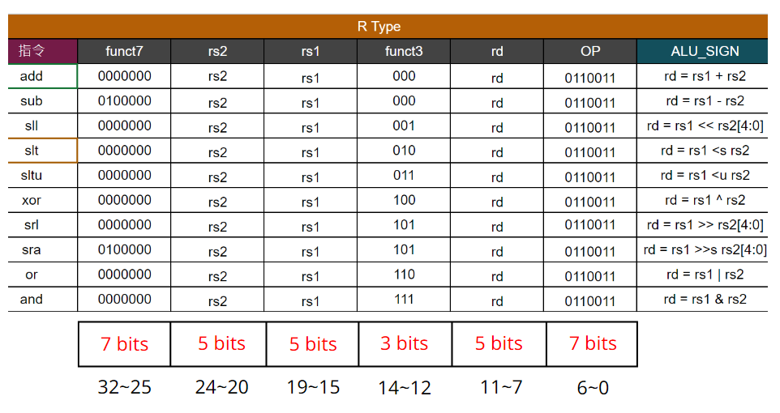
010101001111010101001100010101010101010011000101010110100100010101010010
010110110101010101011101011010001001
010101001111010101001100010101010101010011000101010110100100010101010010
010110110101010101011101011010001001

Slide 12

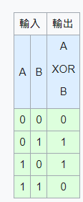
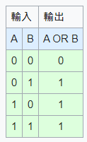
010101001111010101001100010101010101010011000101010110100100010101010010
010110110101010101011101011010001001
add rd = rs1 + rs2 sub rd = rs1 - rs2 and rd = rs1 & rs2 or rd = rs1 | rs2 xor rd = rs1 ^ rs2
010101001111010101001100010101010101010011000101010110100100010101010010
010110110101010101011101011010001001

Slide 13
010101001111010101001100010101010101010011000101010110100100010101010010
010110110101010101011101011010001001
邏輯左移: sll rd = rs1 << rs2[4:0] 邏輯右移: srl rd = rs1 >> rs2[4:0] 算數右移: sra rd = rs1 >>s rs2[4:0]
0 | 0 | 0 | 0 | 1
0 | 0 | 1 | 0 | 0
<< 2 (00010)
1 | 0 | 0 | 0 | 0
0 | 0 | 1 | 0 | 0
>> 2 (00010)
1 | 0 | 0 | 0 | 0
1 | 1 | 1 | 0 | 0
>>s 2 (00010)
010101001111010101001100010101010101010011000101010110100100010101010010
010110110101010101011101011010001001

Slide 14
010101001111010101001100010101010101010011000101010110100100010101010010
010110110101010101011101011010001001
slt if (rs1<rs2) rd=1 else rd=0 sltu if ( |rs1| < |rs2| ) rd=1 (比較時視為無號數) else rd=0
010101001111010101001100010101010101010011000101010110100100010101010010
010110110101010101011101011010001001

Slide 15
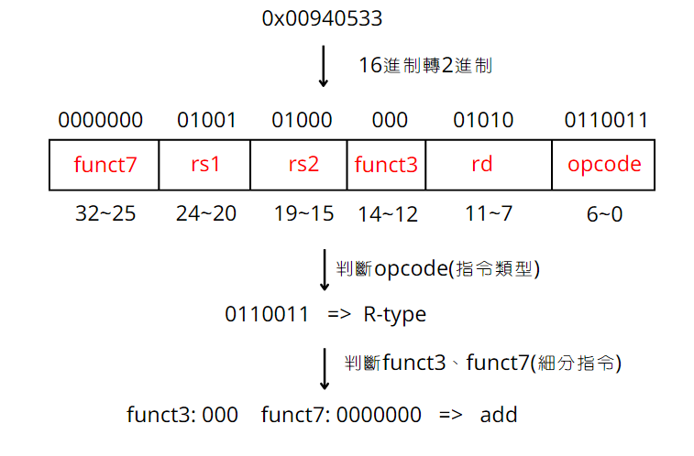
010101001111010101001100010101010101010011000101010110100100010101010010
010110110101010101011101011010001001
010101001111010101001100010101010101010011000101010110100100010101010010
010110110101010101011101011010001001

Slide 16
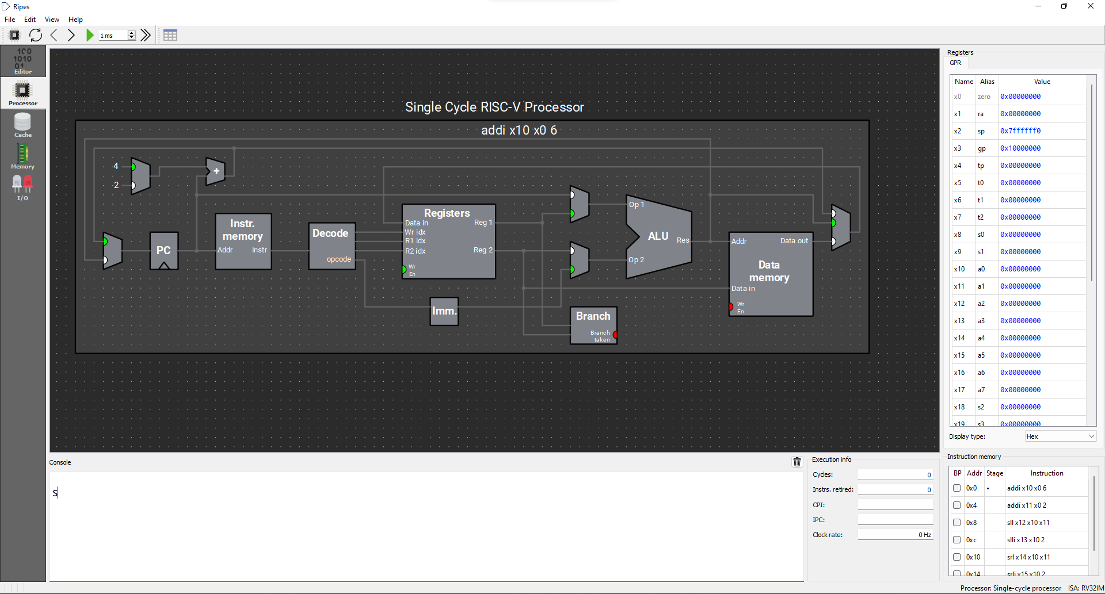

010101001111010101001100010101010101010011000101010110100100010101010010
010110110101010101011101011010001001
圖片來源：Ripes - visual computer architecture simulator
010101001111010101001100010101010101010011000101010110100100010101010010
010110110101010101011101011010001001

Slide 17
010101001111010101001100010101010101010011000101010110100100010101010010
010110110101010101011101011010001001
Any Question?
010101001111010101001100010101010101010011000101010110100100010101010010
010110110101010101011101011010001001

